Slide 1
Class and Object

Slide 2
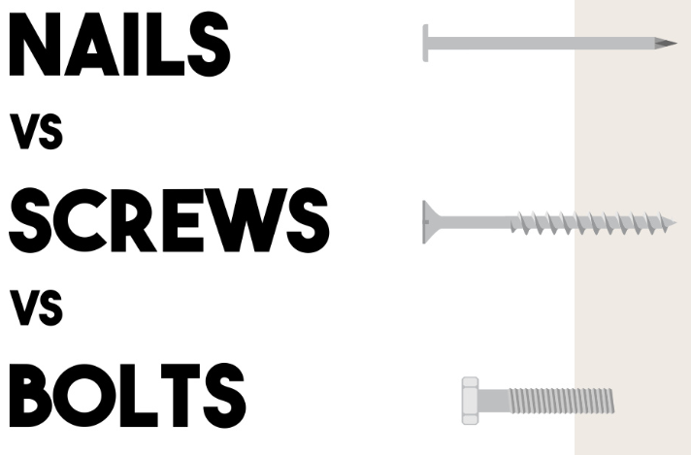
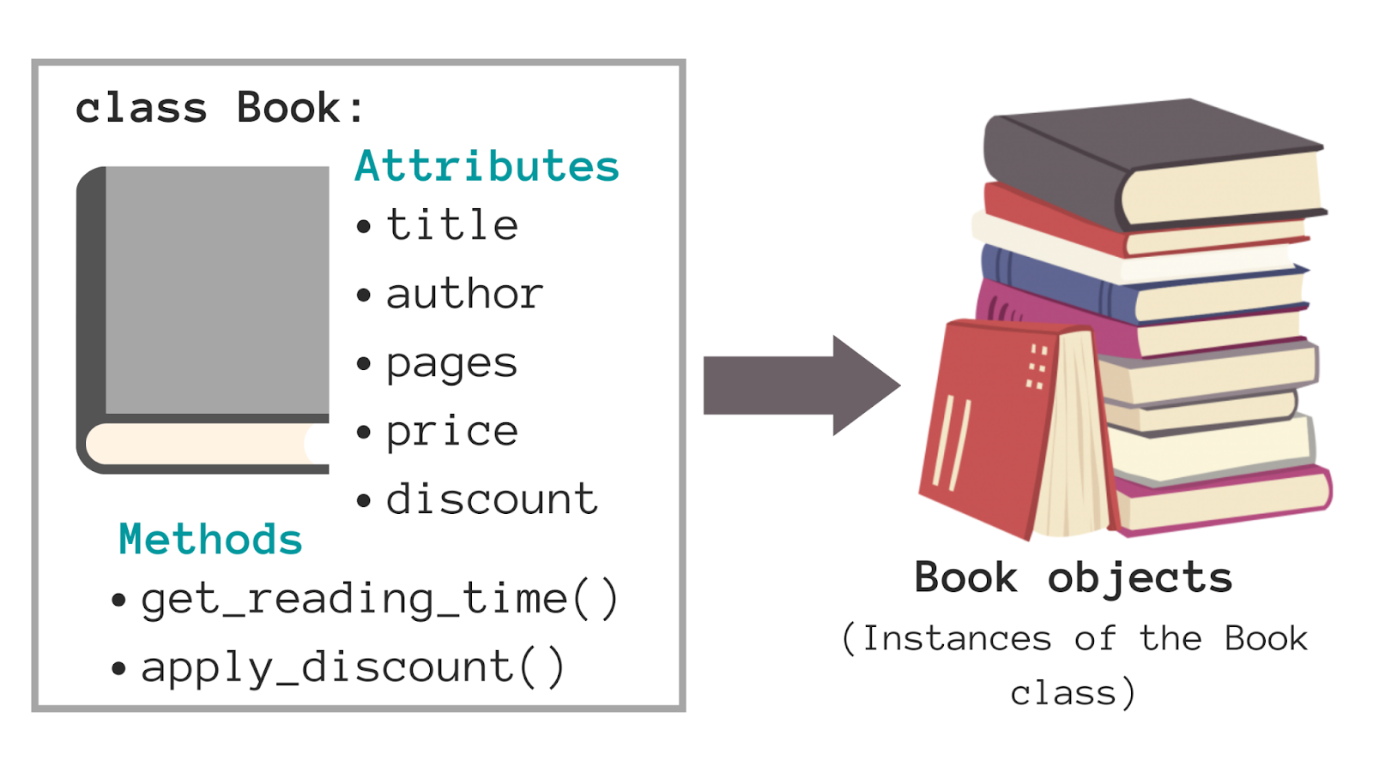


Introducing the Analogy
"Navigating Complexity: Lessons from Engineering and Art"
"Understanding Classes and Objects in OOAD"
Analogizing the Engineer, Artist, and Software Developer
Drawing parallels between materials in different trades and objects vs. classes in software
Emphasizing the importance of material properties and their appropriate use

Slide 3

The Nature of an Object
Meet the Virtual 'Play-Doh': Understanding Objects
Comparing objects to Play-Doh creations that have identity, shape, and purpose
Discovering how objects become a part of our digital playground

Slide 4
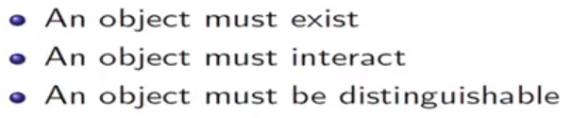
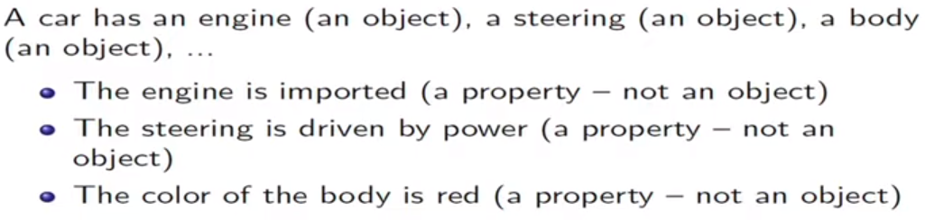
What Is and What Isn't an Object?
Notes:
For example, in philosophy or abstract discussions, concepts like justice, freedom, or democracy can be considered objects because they are not tangible physical entities but are concepts that can be understood and discussed through intellectual exploration.
Certain qualities like beauty, color, emotions (love, anger) are not objects in themselves but rather attributes or characteristics. They don't have the same tangible structure as traditional objects. However, they can still be associated with objects or used to describe properties of objects.

Slide 5
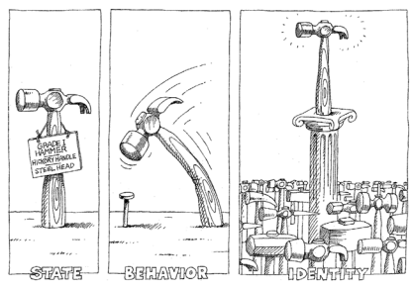
What does an object have?
The structure and behavior of similar objects are defined in their common class.
The terms instance and object are interchangeable.

Slide 6
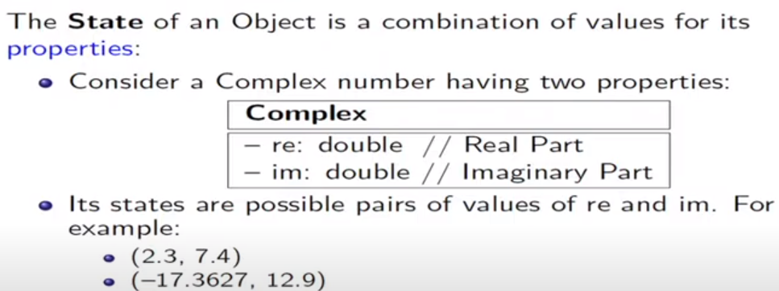
State of an object

Slide 7
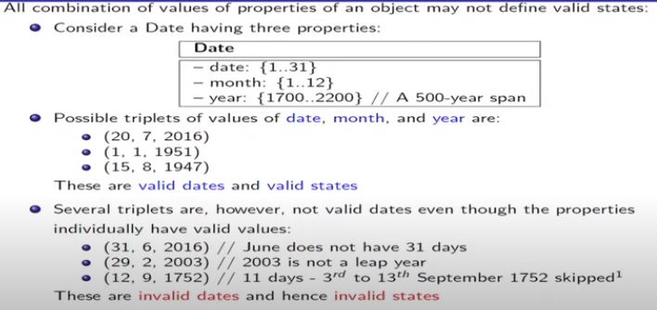
STATE of a DATE object
Notes:
eleven days (September 3-13) were deleted forever from the calendar by the British Government to align it with the one used in Europe, a shift from the Julian calendar to the Gregorian calendar

Slide 8
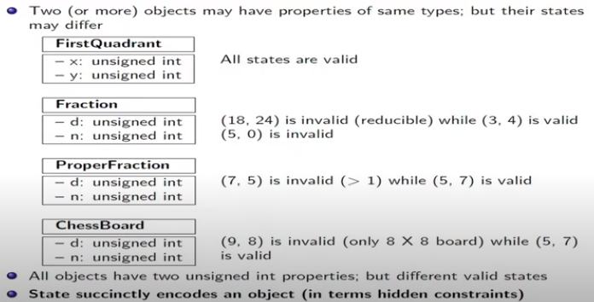
STATE encodes constraints

Slide 9
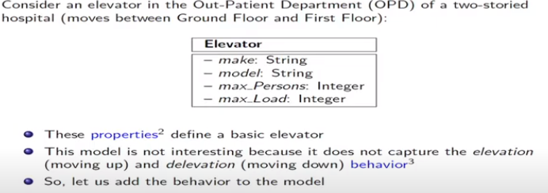
STATE of an Elevator

Slide 10
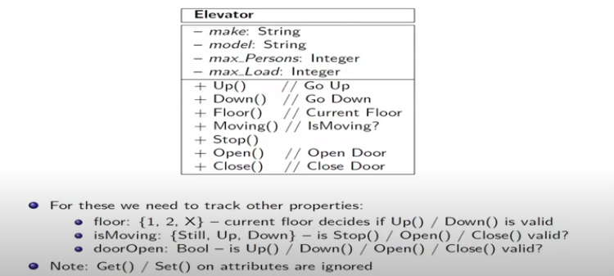
An Elevator

Slide 11
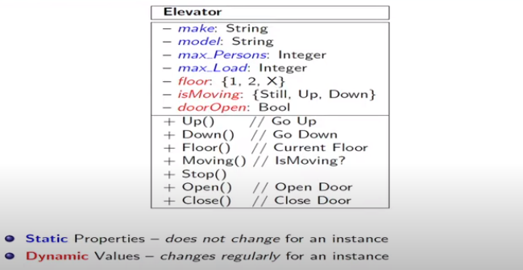
An Elevator

Slide 12
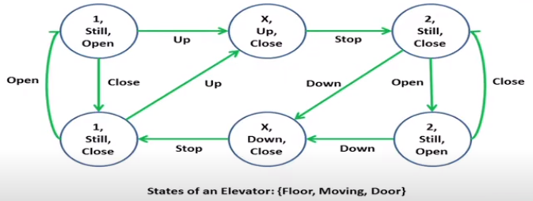
An Elevator - States

Slide 13
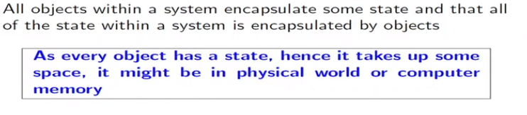
STATE
The state of an object encompasses all of the (usually static) properties of the object plus the current (usually dynamic) values of each of these properties.

Slide 14
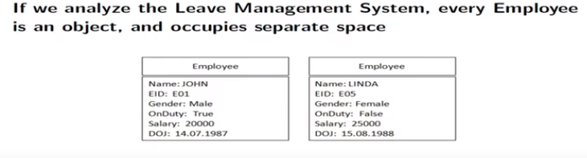
STATE Space

Slide 15
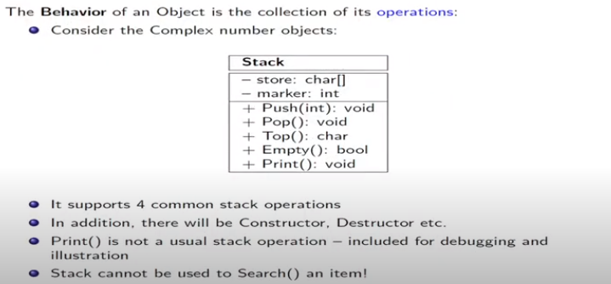
Behavior

Slide 16
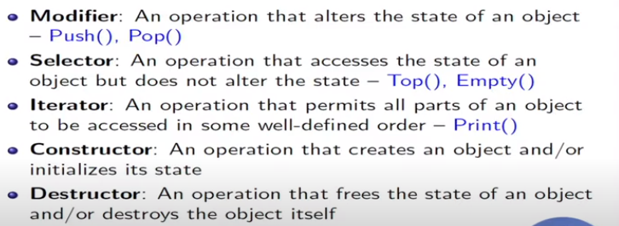
Common Operations of an Object

Slide 17
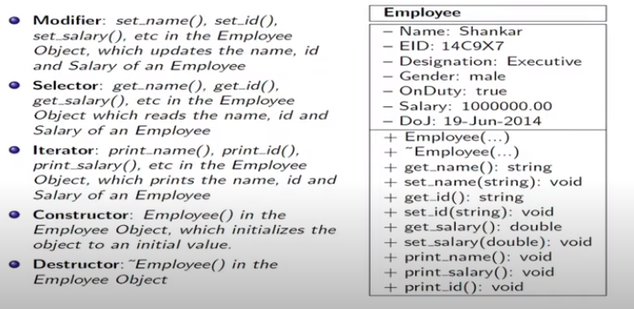
Employee LMS

Slide 18
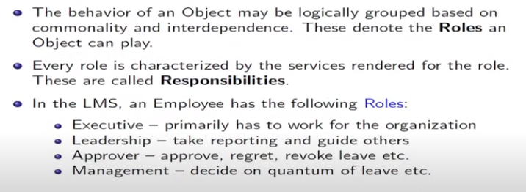
Roles and Responsibilities

Slide 19
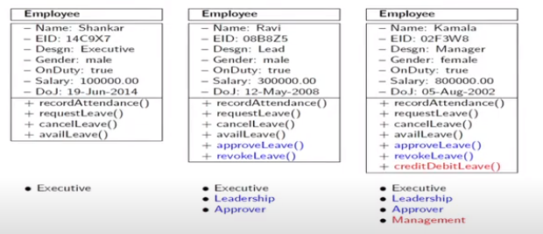
Roles and Responsibilities

Slide 20
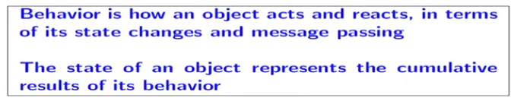
BEHAVIOR of an Object

Slide 21
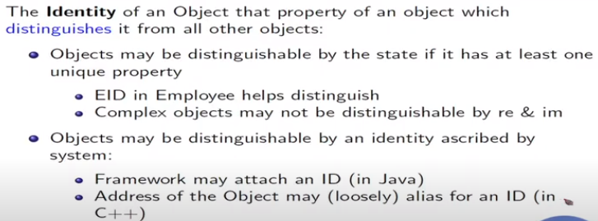
IDENTITY of an Object

Slide 22
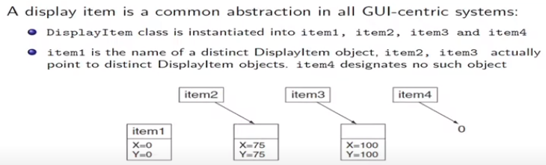
IDENTITY of a Display Object

Slide 23
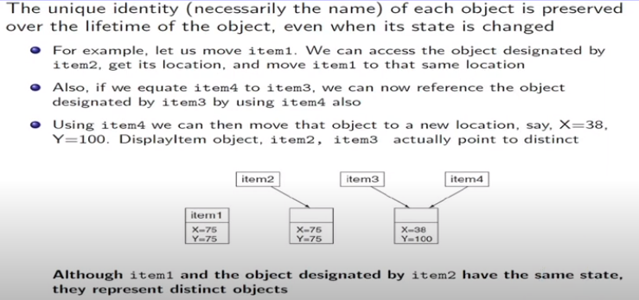
IDENTITY of a Display Object

Slide 24
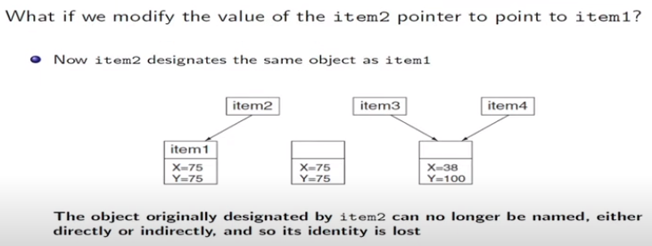
IDENTITY of a Display Object

Slide 25
Relationships among Objects

Slide 26
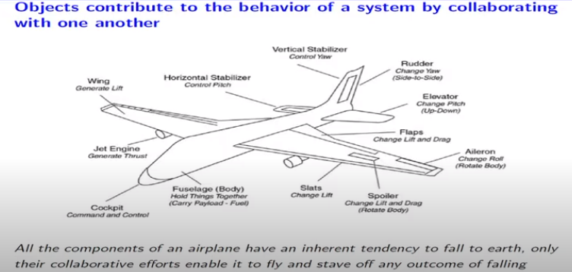
Relationships among Objects

Slide 27
Relationships among Objects
Links (association)
Aggregation

Slide 28
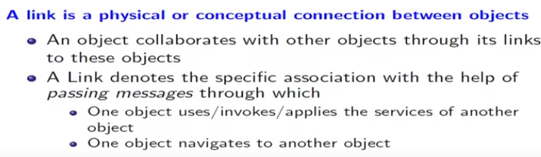
Links (Association)

Slide 29
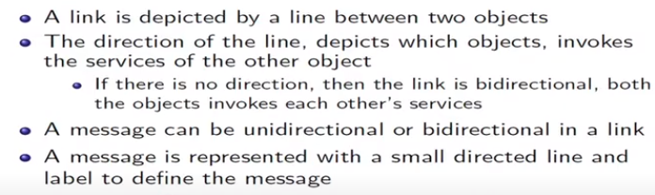
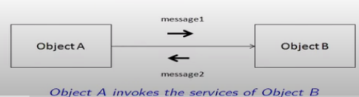
Notation

Slide 30
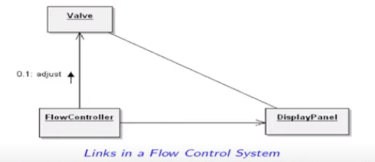
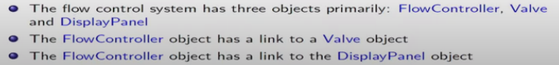
A Flow Control System

Slide 31
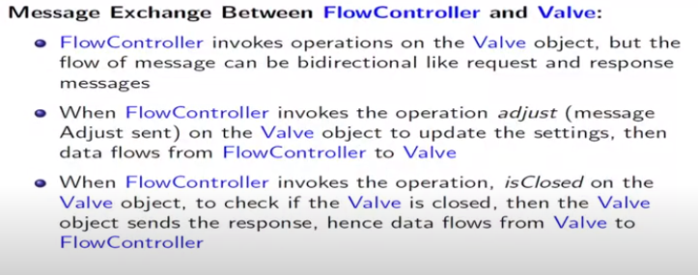
Understanding Messages between Objects

Slide 32
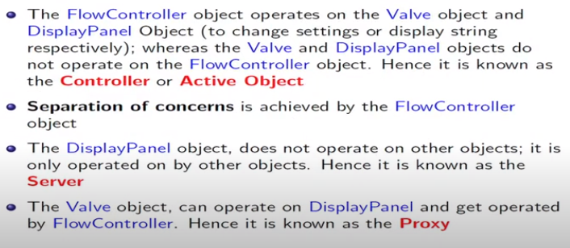
Roles of participating objects in a link

Slide 33
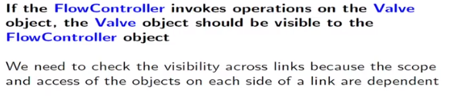
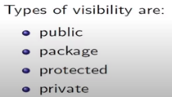
Visibility

Slide 34
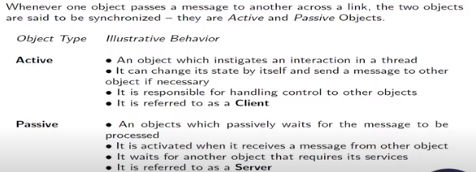
Synchronization

Slide 35
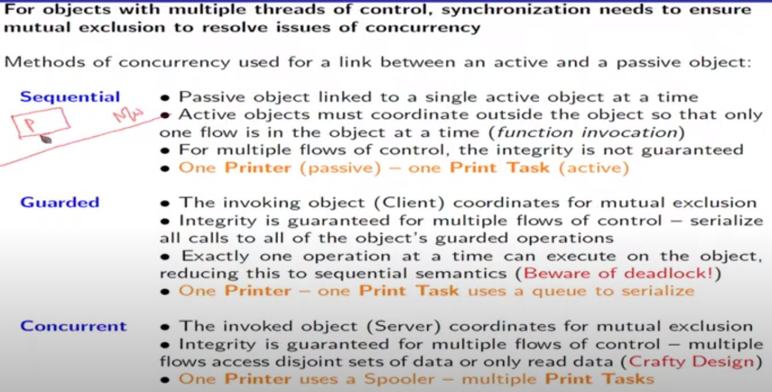
Synchronization

Slide 36
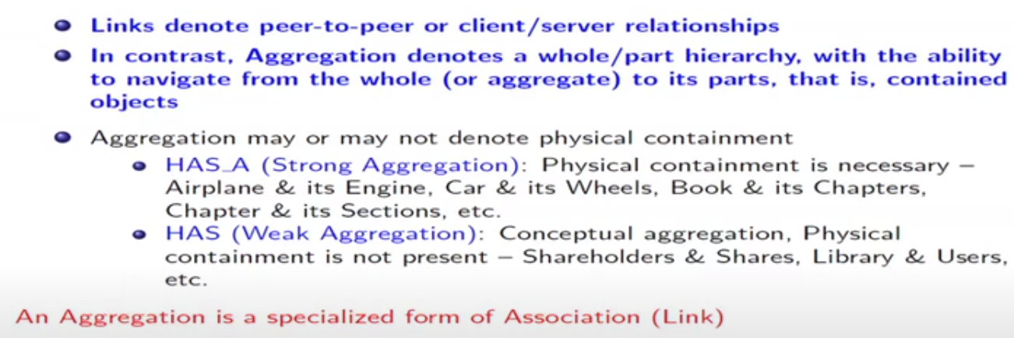
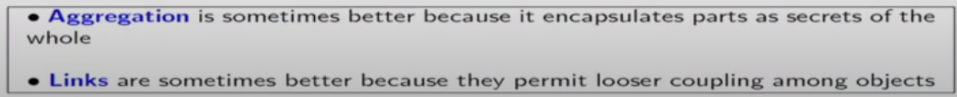
Aggregation

Slide 37
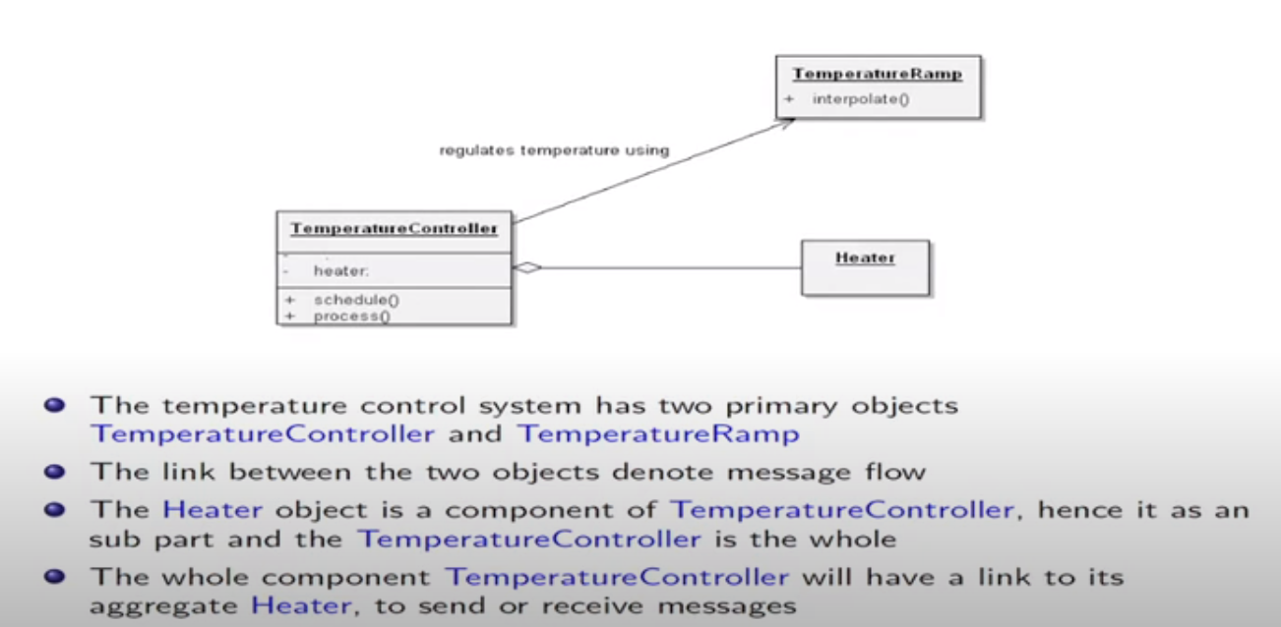
Temperature control system

Slide 38
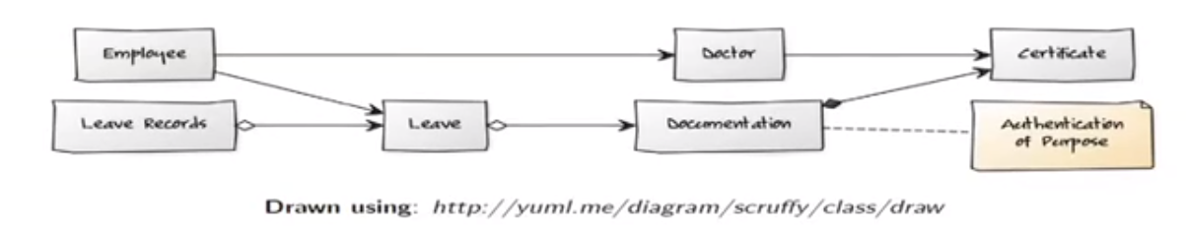
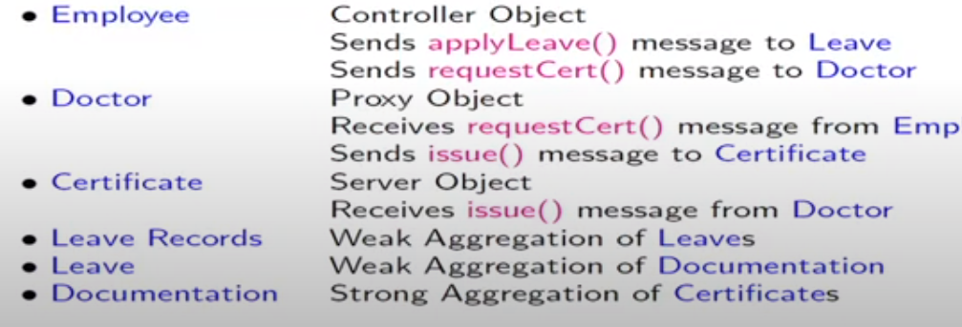
LMS

Slide 39
Nature of classes

Slide 40
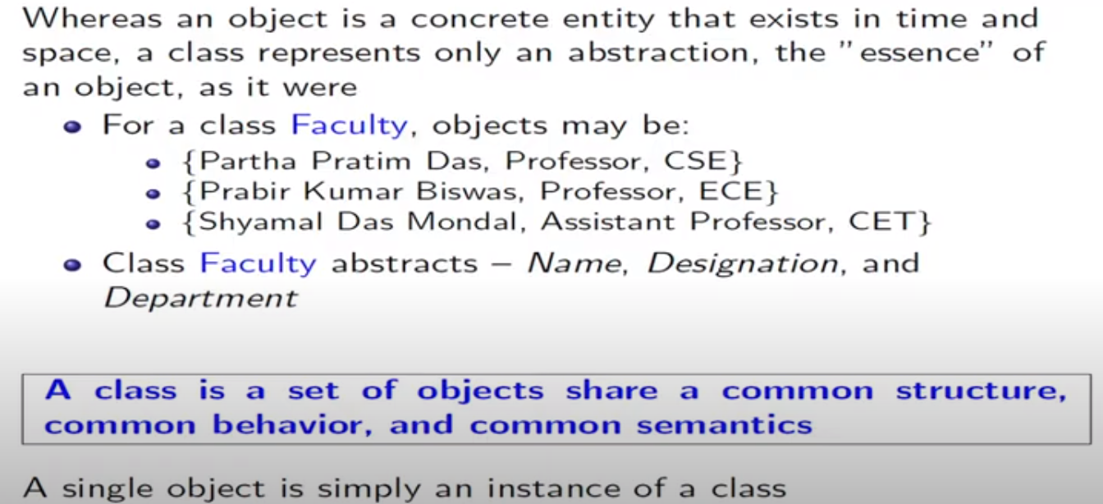
What is Class?

Slide 41
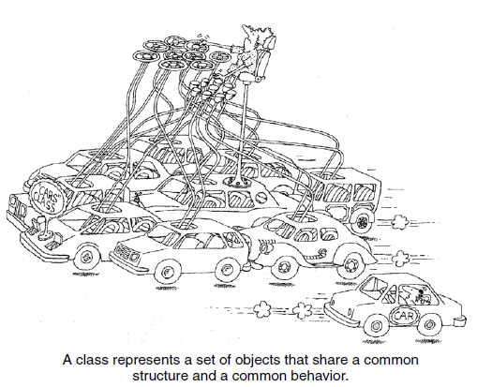

Slide 42
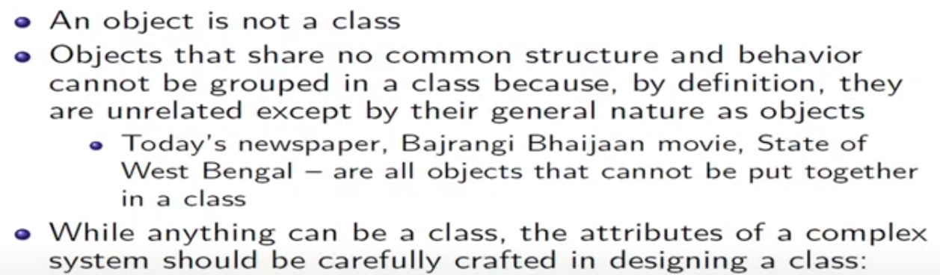
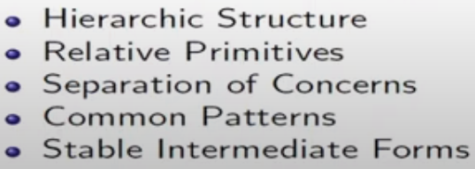
What is not a class?

Slide 43
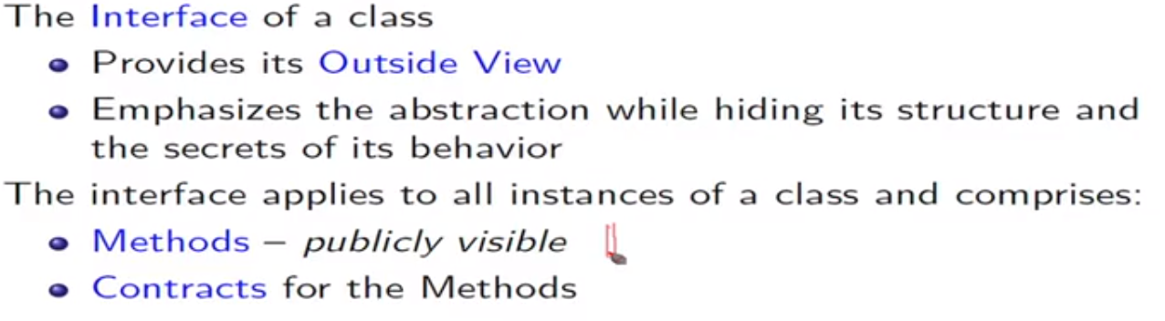
Interface

Slide 44
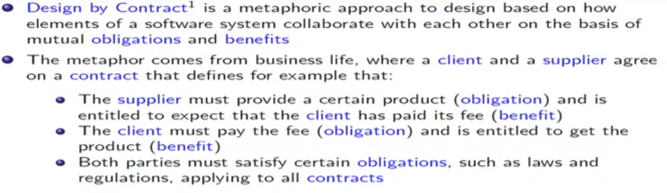
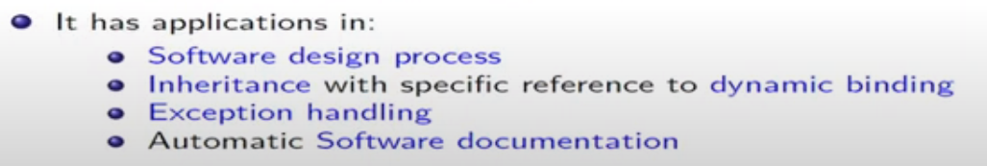
Design by Contract

Slide 45
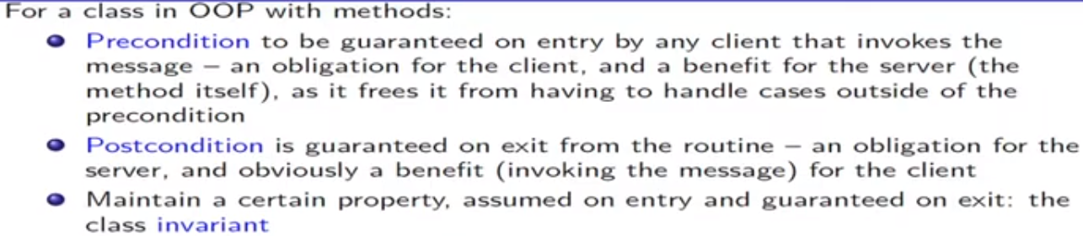
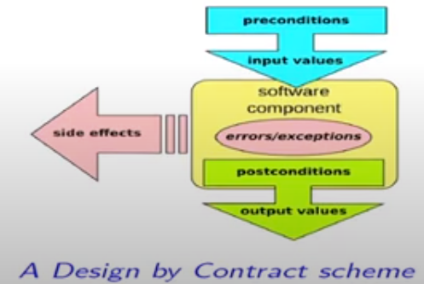
Design by Contract

Slide 46

Example of stack

Slide 47

Visibility

Slide 48

Visibility

Slide 49

Implementation

Slide 50

Implementation: Stack

Slide 51
Relationships among classes

Slide 52
Relationships
Association
Inheritance
Aggregation
Dependencies

Slide 53


Relationships between classes

Slide 54

Relationships between classes

Slide 55

Association

Slide 56

Association

Slide 57

Inheritance

Slide 58

Single Inheritance

Slide 59

Polymorphism

Slide 60

Multiple Inheritance

Slide 61


Slide 62


Aggregation

Slide 63

Dependencies

